Slide 1
THREE STATES
OF MATTER
By T. Sudarat Khampa

Slide 2
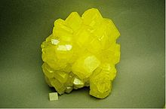

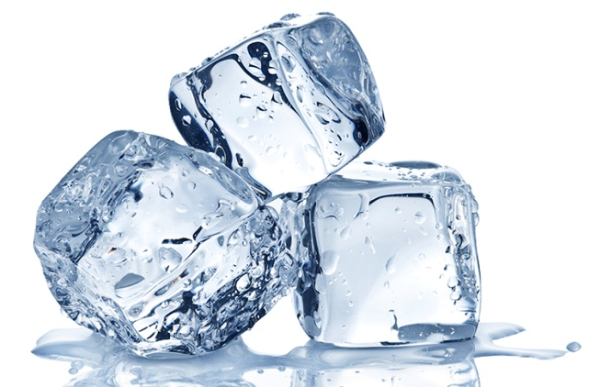
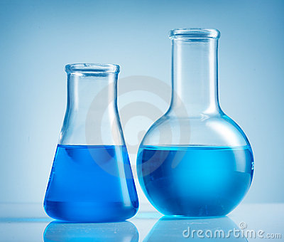

What is matter?
Matter is anything that has mass and
takes up space.

Slide 3
Properties of Matter
How It Looks (Shiny ,Dull, Color, etc.)
How It Feels (Hard, Soft, Rough , Smooth, etc.)
How It Smells (Sweet, Sharp, Terrible, No Smell, etc.)
How It Sounds (Loud, Soft, Echo, No Sound, etc.)
What It Does (Bounce, Stretch, Tear, Break, Magnetism etc.)

Slide 4
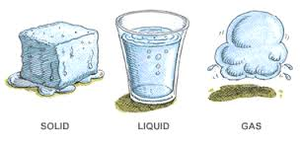
STATES OF MATTER
Based upon particle arrangement
Based upon energy of particles
Based upon distance between particles

Slide 5
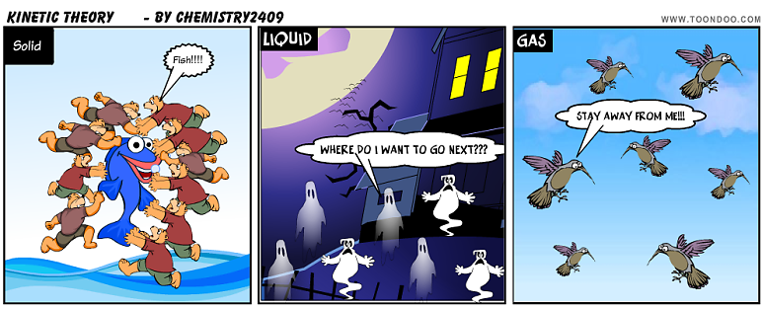
Kinetic Theory of Matter
Matter is made up of particles which are in continual random motion.

Slide 6
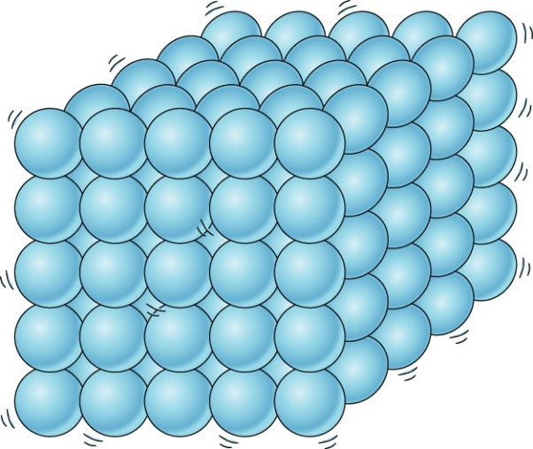
STATES OF MATTER
SOLIDS
Has a fixed shape
Has a fixed volume
Particles are arranged in a tight, regular pattern
Particles move very little

Slide 7
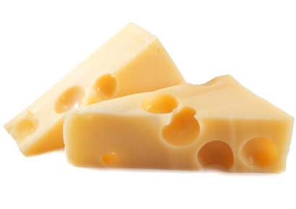
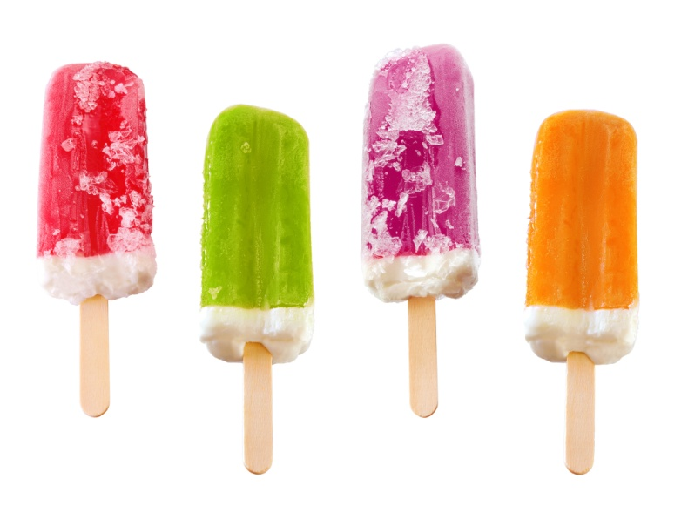
Examples of Solids are
Ice
Frog
Cheese
Bricks
Wood
Popcicle

Slide 8
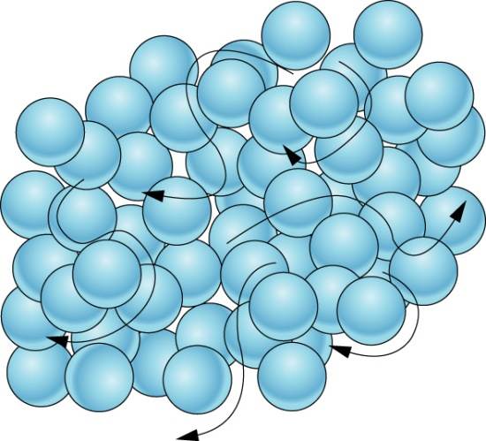
STATES OF MATTER
LIQUID
Has no fixed shape
Has a fixed volume
Particles move past one another easily
Particles are fairly close, but not in a neat even arrangement as the particles in a solid are

Slide 9
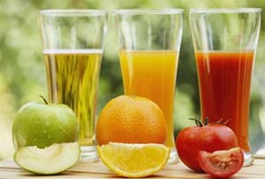
Examples of Liquid are
Orange Juice
Water
Soft drinks
Milk
Rubbing Alcohol
Vinegar

Slide 10
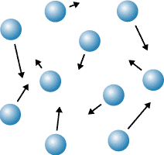
STATES OF MATTER
GAS
Has no fixed shape
Has no fixed volume
Made of particles that move rapidly
The particles also have large spaces between them in comparison to solids and liquids

Slide 11
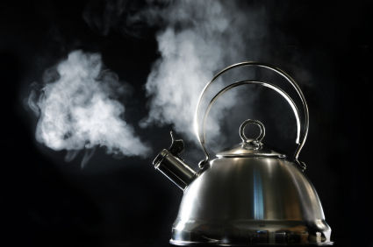
Examples of Gas are
Steam
Oxygen
Carbon dioxide
Smog
Tear Gas
Helium

Slide 12
PHASE CHANGES
Description of Phase Change | Term for Phase Change | Heat Movement During Phase Change
Solid to liquid | Melting | Heat goes into the solid as it melts.
Liquid to solid | Freezing | Heat leaves the liquid as it freezes.

Slide 13
PHASE CHANGES
Description of Phase Change | Term for Phase Change | Heat Movement During Phase Change
Liquid to gas | boiling and evaporation | Heat goes into the liquid as it vaporizes.
Gas to liquid | Condensation | Heat leaves the gas as it condenses.
Solid to gas | Sublimation | Heat goes into the solid as it sublimates.

Slide 14
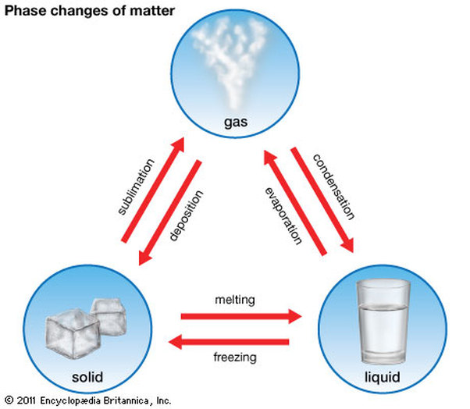
PHASE CHANGES

Slide 15
Quiz
1. What state of matter has a definite shape,
a definite volume and cannot flow?
SOLID

Slide 16
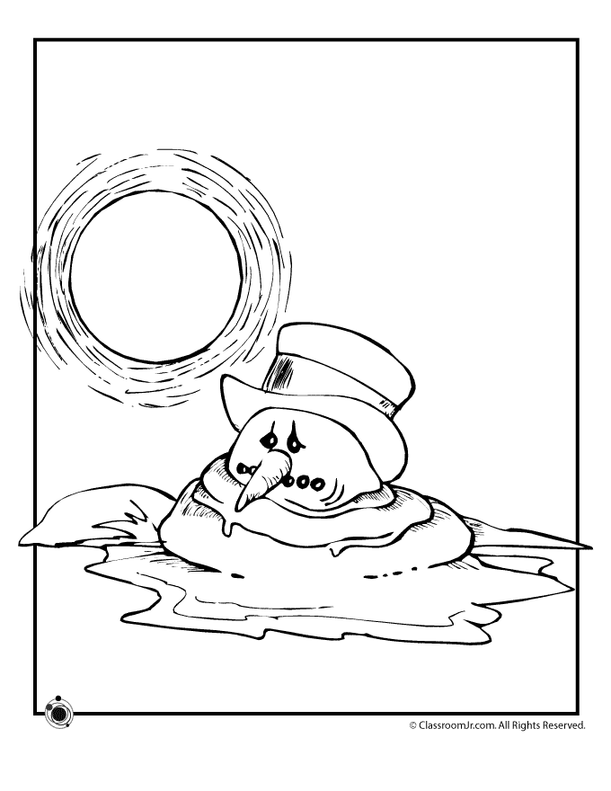
Quiz
2. This picture, What is physical process change in state of matter.
MELTING

Slide 17
Quiz
3. When a gas is compressed it changes state
into a ………..
LIQUID

Slide 18
Quiz
4. …………………. is the change in state of a solid to liquid.
MELTING

Slide 19
Quiz
5. What state of matter has a free shape,
a definite volume?
LIQUID

Slide 20
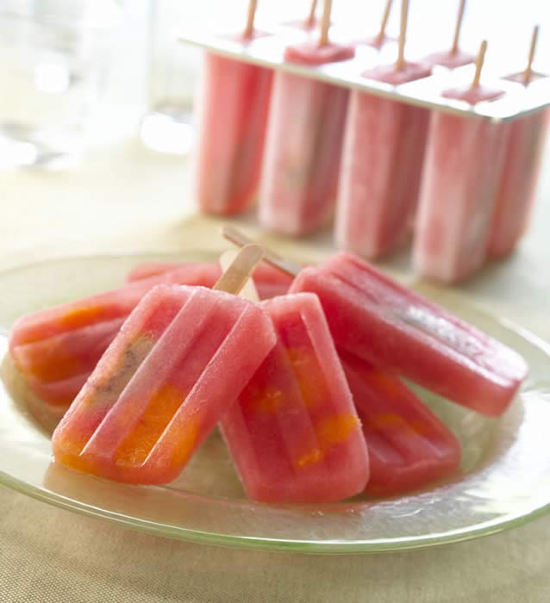
Quiz
6. This picture, What is physical process change in state of matter.
FREEZING

Slide 21
Quiz
7. …………………. is the change in state of a solid to gas.
SUBLIMATION

Slide 22
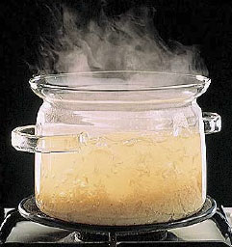
Quiz
8. This picture, What is physical process change in state of matter.
EVAPORATION

Slide 23
Quiz
9. What state of matter has a no fixed shape and volume?
GAS

Slide 24
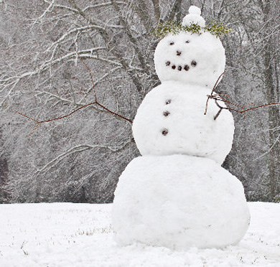
Quiz
10. This picture, What is physical process change in state of matter.
DEPOSITION

Slide 25
Quiz
11. …………………. is the change in state of a liquid to gas.
EVAPORATION

Slide 26

Quiz
12. What state of this particle?
SOLID

Slide 27
Quiz
13. …………………. is the change in state of a liquid to solid.
FREEZING

Slide 28

Quiz
14. This picture, What is physical process change in state of matter.
CONDENSATION

Slide 29
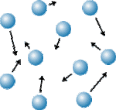
Quiz
15. What state of this particle?
GAS

Slide 30
Quiz
16. …………………. is the change in state of a gas to liquid.
CONDESATION

Slide 31
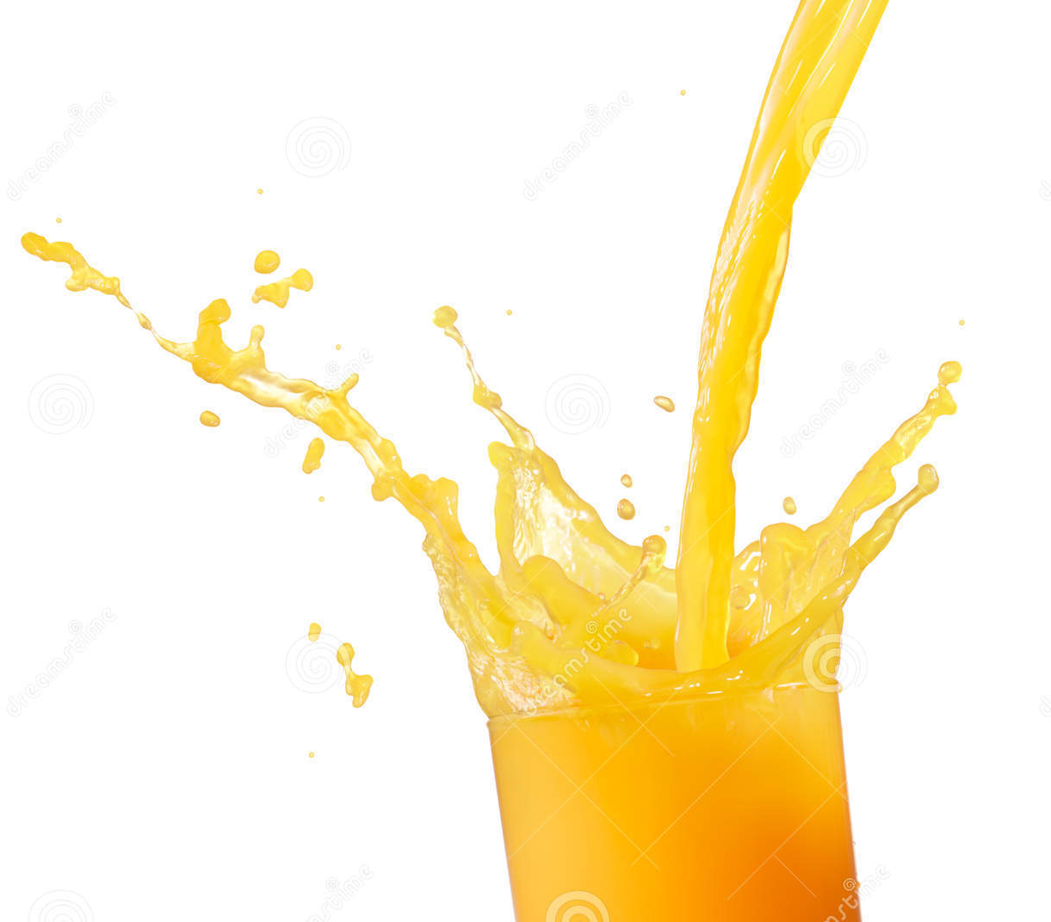
Quiz
17. What is a state of matter in this picture?
LIQUID

Slide 32
Quiz
18. What state of this particle?
LIQUID

Slide 33
Quiz
19. …………………. is the change in state of a gas to solid.
DEPOSITION

Slide 34
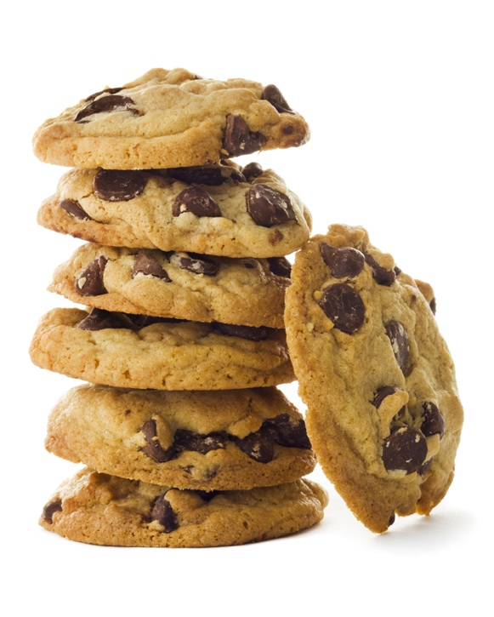
Quiz
20. What is a state of matter in this picture?
SOLID

